Slide 1
Machine Learning Algorithms (IV)
Master´s in Applied Artificial Intelligence
Luís Ferreira
lufer@ipca.pt

Slide 2
Overview
Part I
Artificial Intelligence and Machine Learning
Foundations
Part II
Machine Learning
Part III
Machine Learning Algorithms
Parte V
Advanced ML
Parte IV
Building a ML Model

Slide 3
Part III
Machine Learning Algorithms
Competencies to be acquired:
Choosing ML Algorithms
Pipeline process

Slide 4
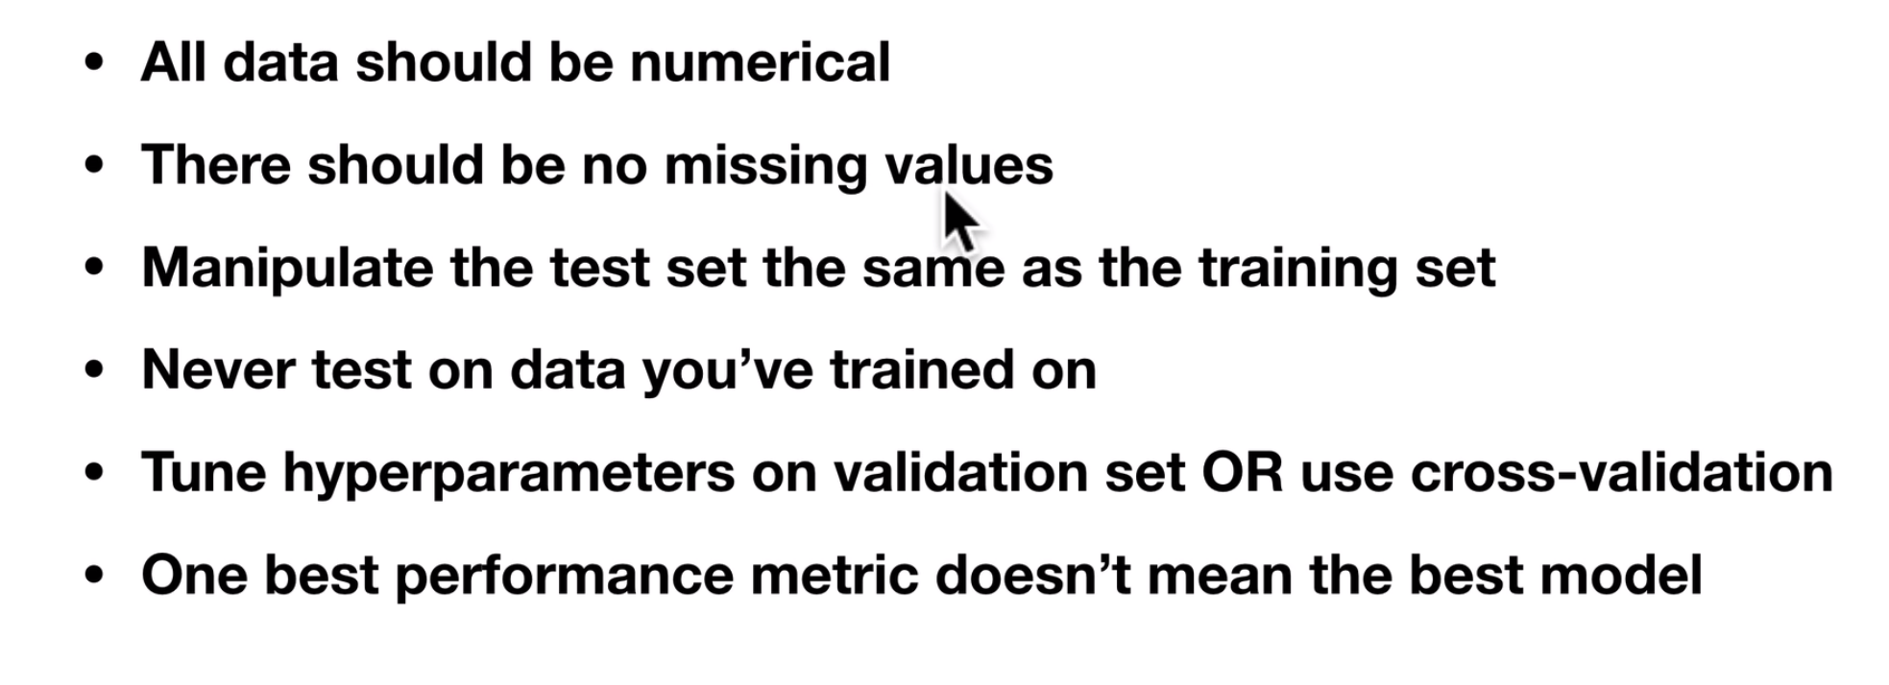
Part III: MLA
Remember
Notes:
141

Slide 5
Part III: MLA
ML Pipeline
ML Pipeline
(…) is a series of interconnected data processing and modelling steps designed to automate, standardize and streamline the process of building, training, evaluating and deploying machine learning models (…)
IBM
Notes:
https://neptune.ai/blog/data-science-pipelines-with-kedro

Slide 6
Part III: MLA
ML Pipeline
ML Pipeline advantages
  Modularization: Pipelines enable you to break down the machine learning process into modular, well-defined steps
  Reproducibility: Machine learning pipelines make it easier to reproduce experiments
  Efficiency: Pipelines automate many routine tasks, such as data preprocessing, feature engineering and model evaluation
  Scalability: Pipelines can be easily scaled to handle large datasets or complex workflows
IBM
Notes:
https://neptune.ai/blog/data-science-pipelines-with-kedro

Slide 7
Part III: MLA
ML Pipeline
ML Pipeline advantages
  Experimentation: You can experiment with different data preprocessing techniques, feature selections, and models by modifying individual steps within the pipeline
  Deployment: Pipelines facilitate the deployment of machine learning models into production
  Collaboration: Pipelines make it easier for teams of data scientists and engineers to collaborate
  Version control and documentation: You can use version control systems to track changes in your pipeline's code and configuration, ensuring that you can roll back to previous versions if needed.
IBM
Notes:
https://neptune.ai/blog/data-science-pipelines-with-kedro

Slide 8
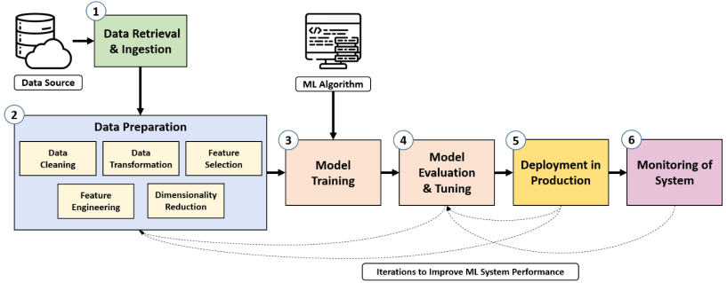
Part III: MLA
ML Pipeline
ML Pipeline steps:
Notes:
https://neptune.ai/blog/data-science-pipelines-with-kedro

Slide 9
Part III: MLA
ML Pipeline
Pipeline Real Examples:
Software Industry — Dropbox built a modern optical character recognition pipeline to create a mobile document scanning feature.
Transportation Industry — Lyft utilized an in-house pipeline framework to accelerate machine learning and data orchestration for core ride-hailing functions of pricing, locations, and arrival time estimations.
Insurance Industry — USAA leveraged a machine learning pipeline to improve motor claims processing by creating a service that maps a photo of damaged vehicle parts that should be repaired or replaced.
Healthcare Industry — The UK’s National Health System (NHS) developed and deployed a suite of machine learning pipelines as part of a national hospital capacity planning system for COVID-19.
Notes:
https://neptune.ai/blog/data-science-pipelines-with-kedro

Slide 10
Part III: MLA
ML Pipeline
Pipeline creation by hand:
# Put models in a dictionary
models = {
"Logistic Regression": LogisticRegression(),
"KNN": KNeighborsClassifier(),
"Random Forest": RandomForestClassifier()
}
# Make a dictionary to keep model scores
model_scores = {}
# Loop through models
for name, model in models.items():
# Fit the model to the data
model.fit(X_train, y_train)
# Evaluate the model and keep its score
model_scores[name] = model.score(X_test, y_test)
Notes:
https://neptune.ai/blog/data-science-pipelines-with-kedro

Slide 11
Part III: MLA
ML Pipeline
Pipeline assisted creation:
class sklearn.pipeline.Pipeline(steps, *, memory=None, verbose=False)
Where ‘steps’= list of tuples (name, model)
Example: To impute different features with different arbitrary values, it is needed to set up several SimpleImputer steps within a pipeline and then join them with the ColumnTransformer

Slide 12
Part III: MLA
ML Pipeline
Pipeline assisted creation:
class sklearn.pipeline.Pipeline(steps, *, memory=None, verbose=False)
Where `steps`= list of tuples (name, model)
The SimpleImputer class provides basic strategies for imputing missing values.
Missing values can be imputed with a provided constant value, or using the statistics (mean, median or most frequent) of each column in which the missing values are located.
Example: To impute different features with different arbitrary values, it is needed to set up several SimpleImputer steps within a pipeline and then join them with the ColumnTransformer

Slide 13
Part III: MLA
ML Pipeline
Pipeline creation:
categorical_transformer = Pipeline(steps=[
(“missing", SimpleImputer(strategy="constant", fill_value="missing")),
("onehot", OneHotEncoder(handle_unknown="ignore"))]
)
class sklearn.pipeline.Pipeline(steps, *, memory=None, verbose=False)
Where `steps`= list of tuples (name, model)
The imputer missing imputes missing values with the constant value “missing”
Categorical features will be one-hot encoded, and any previously unseen categories in the test data will be ignored instead of causing an error.
Thus, the imputer fills missing values first, and then one-hot encoding converts them into binary columns
Notes:
https://neptune.ai/blog/data-science-pipelines-with-kedro

Slide 14
Part III: MLA
ML Pipeline
Pipeline creation:
# this imputer imputes categorical features with 4
door_transformer = Pipeline(steps=[
("imputer", SimpleImputer(strategy="constant", fill_value=4))
])
# this imputer imputes numerics missing values with the mean
numeric_transformer = Pipeline(steps=[
("imputer", SimpleImputer(strategy="mean"))
])
class sklearn.pipeline.Pipeline(steps, *, memory=None, verbose=False)
Where `steps`= list of tuples (name, model)
Notes:
https://neptune.ai/blog/data-science-pipelines-with-kedro

Slide 15
Part III: MLA
ML Pipeline
Pipeline creation:
Apply this pipe…
…to these features
# put the features list and the transformers together with ColumnTransformer
preprocessor = ColumnTransformer(
transformers=[
#categorical_features = ["Make", "Colour"]
("cat", categorical_transformer, categorical_features),
("door", door_transformer, door_feature), #door_feature = ["Doors"]
# numeric_features = ["Odometer (KM)"]
("num", numeric_transformer, numeric_features)])])
class sklearn.pipeline.Pipeline(steps, *, memory=None, verbose=False)
Where `steps`= list of tuples (name, model)
Notes:
https://neptune.ai/blog/data-science-pipelines-with-kedro

Slide 16
Part III: MLA
ML Pipeline
Pipeline creation:
Execute this pipe first…
…then this
# pipeline for model creation
model = Pipeline(steps=[
("preprocessor", preprocessor),
("model", RandomForestRegressor(n_jobs=-1))
])
class sklearn.pipeline.Pipeline(steps, *, memory=None, verbose=False)
Where `steps`= list of tuples (name, model)
Notes:
https://neptune.ai/blog/data-science-pipelines-with-kedro

Slide 17
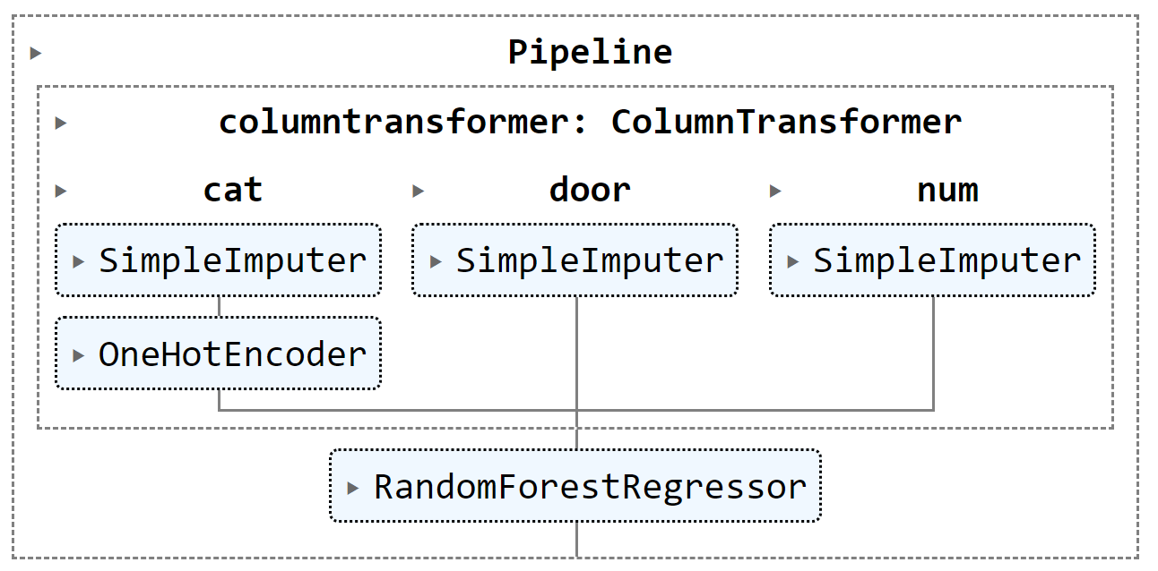
Part III: MLA
ML Pipeline
Pipeline creation:
Execute this pipe first…
…then this
# pipeline for model creation
model = Pipeline(steps=[
("preprocessor", preprocessor),
("model", RandomForestRegressor(n_jobs=-1))
])
class sklearn.pipeline.Pipeline(steps, *, memory=None, verbose=False)
Where `steps`= list of tuples (name, model)
Notes:
https://neptune.ai/blog/data-science-pipelines-with-kedro

Slide 18
Part III: MLA
ML Pipeline
Model Improvement with Pipeline (using GridSearchCV ):
#parameters for GridSearchCV
pipe_grid = {
"preprocessor__num__imputer__strategy": ["mean", "median"],
"model__n_estimators": [100, 1000],
"model__max_depth": [None, 5],
"model__max_features": ["sqrt"],
"model__min_samples_split": [2, 4]
}
class sklearn.pipeline.Pipeline(steps, *, memory=None, verbose=False)
Where `steps`= list of tuples (name, model)
key of the pipe step…
Key name numeric transformer
Key name of imputer
Parameter of SimpleInputer
Notes:
https://neptune.ai/blog/data-science-pipelines-with-kedro

Slide 19
Part III: MLA
ML Pipeline
Pipeline with GridSearchCV for Model Improvement:
#model creation with Cross-Validation over the “pipe model”
gs_model = GridSearchCV(model, pipe_grid, cv=5, verbose=2)
gs_model.fit(X1_train, y1_train)
class sklearn.pipeline.Pipeline(steps, *, memory=None, verbose=False)
Where `steps`= list of tuples (name, model)
Notes:
https://neptune.ai/blog/data-science-pipelines-with-kedro

Slide 20
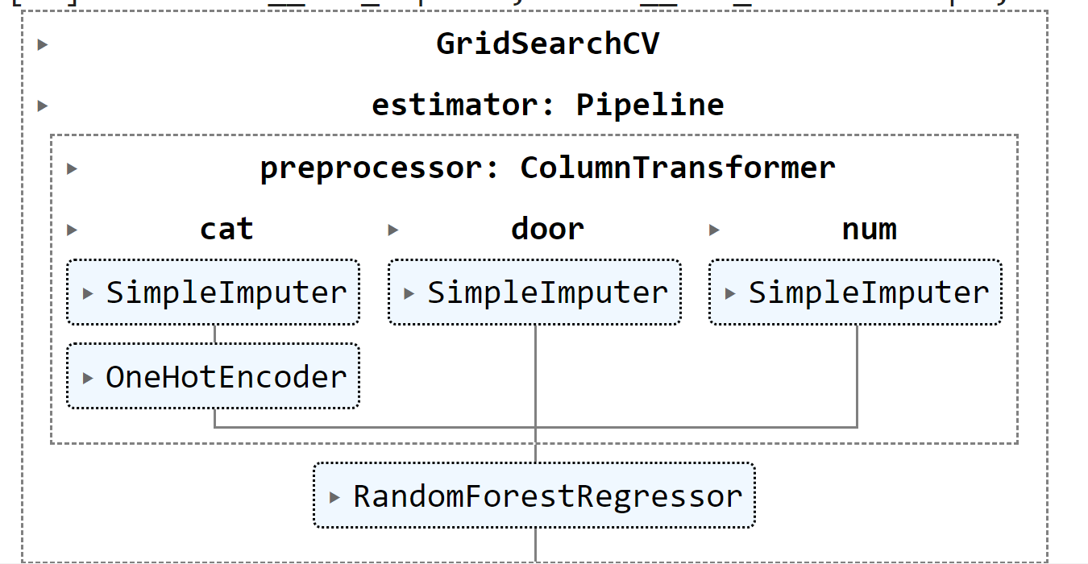
Part III: MLA
ML Pipeline
Pipeline with GridSearchCV for Model Improvement:
#model creation with Cross-Validation over the “pipe model”
gs_model = GridSearchCV(model, pipe_grid, cv=5, verbose=2)
gs_model.fit(X1_train, y1_train)
class sklearn.pipeline.Pipeline(steps, *, memory=None, verbose=False)
Where `steps`= list of tuples (name, model)
Notes:
https://neptune.ai/blog/data-science-pipelines-with-kedro

Slide 21
Part III: MLA
ML Pipeline
Pipeline with tools:
  GitHub Actions
  https://neptune.ai/blog/build-mlops-pipelines-with-github-actions-guide
  Kedro
  https://neptune.ai/blog/data-science-pipelines-with-kedro
  Metaflow
  https://metaflow.org/
  TensorFlow
  https://www.tensorflow.org/?hl=pt
Notes:
https://neptune.ai/blog/building-ml-model-training-pipeline

Slide 22
Part III: MLA
ML Pipeline
See Jupyter Notebbok
  8_ML_Pipelines.ipynb
Notes:
https://neptune.ai/blog/building-ml-model-training-pipeline

Slide 23
Progress
Part I
Artificial Intelligence and Machine Learning
Foundations
Part II
Machine Learning
Part III
Machine Learning Algorithms (I)
Part IV
Advanced ML
Part V
Deep Learning & Neural Networks

Slide 24
References
  Building a Machine Learning Pipeline with Scikit-Learn
    https://towardsdatascience.com/building-a-machine-learning-pipeline-3bba20c2352b
  https://www.ibm.com/topics/machine-learning-pipeline
  https://neptune.ai/blog/best-open-source-mlops-tools
  Machine Learning Lab
    https://openml.org/

Slide 25
References
Machine Learning. Tom M. Mitchel, McGraw-Hill, 1997
Machine Learning for Everyone
  https://vas3k.com/blog/machine_learning/
Machine Learning Tutorial
  https://www.simplilearn.com/tutorials/machine-learning-tutorial/machine-learning-steps
What is machine learning and how does it work? In-depth guide
  https://www.techtarget.com/searchenterpriseai/definition/machine-learning-ML

Slide 26
Appendices

Slide 27
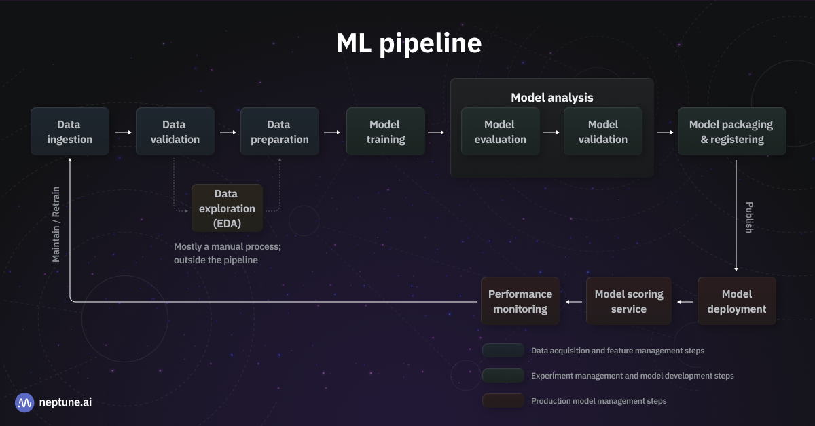
Appendices

